Slide 1
User Stories
Templates & Examples

Slide 2
User Story Template

Slide 3
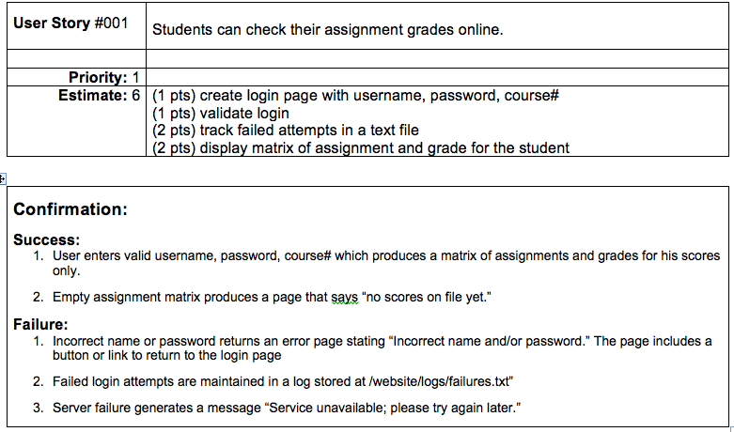
Example from Template

Slide 4
Other Example User Stories*
These were excerpted from http://www.westborosystems.com/2010/02/user-story-examples/
Also see http://agile.csc.ncsu.edu/SEMaterials/tutorials/coffee_maker/ for a great set of examples and tutorials

Slide 5
Key Points
Cards:
physical (or virtual) medium where the story is recorded
Conversation:
Discussion and clarification, modification of the story via communication with the user
Confirmation:
Tests to verify the user story

Slide 6
I.N.V.E.S.T.
I = independent. Not requiring other features.
N = negotiable. Can be excluded, revised, etc.
V = valuable. Clearly contributing to product usefulness
E = estimable. Reasonable development estimates can be made from the story.
S = small. Stories that are too big tend to be vague and to miss the other points, too.
T = testable. Stories need to have a means of verifying functionality.

